Slide 1
職場故事 (animaze)

Slide 2
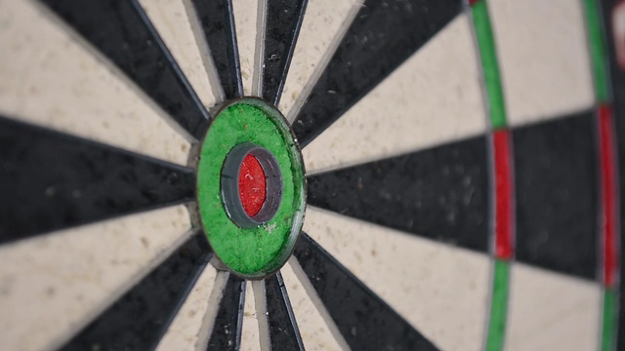
1.目標
Notes:
Video by <a href="https://pixabay.com/users/moos-media-615889/?utm_source=link-attribution&utm_medium=referral&utm_campaign=video&utm_content=19512">Lukas Moos</a> from <a href="https://pixabay.com//?utm_source=link-attribution&utm_medium=referral&utm_campaign=video&utm_content=19512">Pixabay</a>

Slide 3
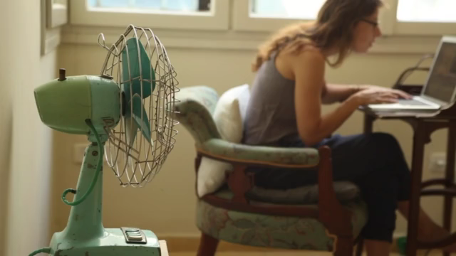
Notes:
Video by <a href="https://pixabay.com/users/coverr-free-footage-1281706/?utm_source=link-attribution&utm_medium=referral&utm_campaign=video&utm_content=1028">Coverr-Free-Footage</a> from <a href="https://pixabay.com//?utm_source=link-attribution&utm_medium=referral&utm_campaign=video&utm_content=1028">Pixabay</a>
唸完四年的書，

Slide 4
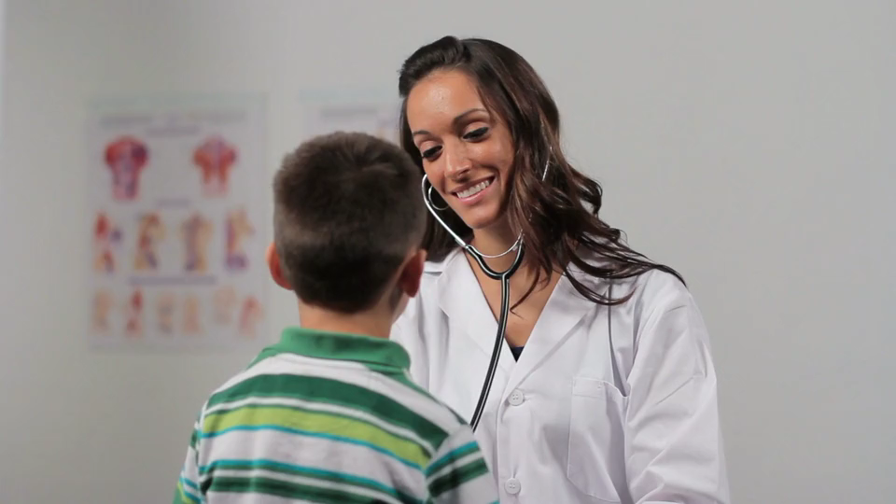
Notes:
Video by <a href="https://pixabay.com/users/hassas_arts-12571684/?utm_source=link-attribution&utm_medium=referral&utm_campaign=video&utm_content=49808">Hassas Arts</a> from <a href="https://pixabay.com//?utm_source=link-attribution&utm_medium=referral&utm_campaign=video&utm_content=49808">Pixabay</a>
我的目標是成為一名能獨當一面、面對任何挑戰都能解決的實習醫師

Slide 5
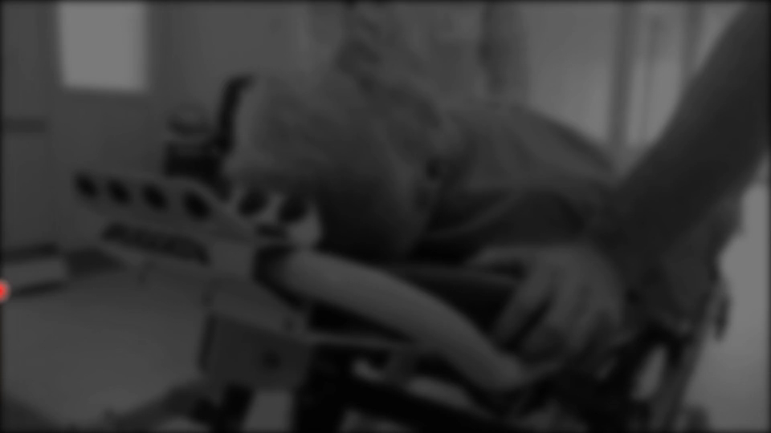
Notes:
Video by <a href="https://pixabay.com/users/conolan-4525104/?utm_source=link-attribution&utm_medium=referral&utm_campaign=video&utm_content=22139">conolan</a> from <a href="https://pixabay.com//?utm_source=link-attribution&utm_medium=referral&utm_campaign=video&utm_content=22139">Pixabay</a>
懷著既緊張又期待的心情，我被分配到急診室實習

Slide 6
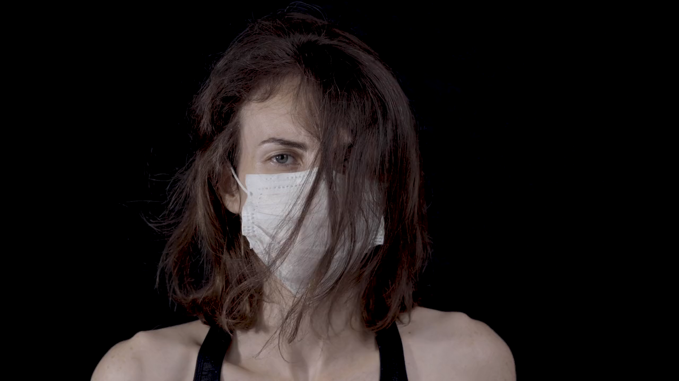
2.阻礙
Notes:
Video by <a href="https://pixabay.com/users/engin_akyurt-3656355/?utm_source=link-attribution&utm_medium=referral&utm_campaign=video&utm_content=44638">Engin Akyurt</a> from <a href="https://pixabay.com//?utm_source=link-attribution&utm_medium=referral&utm_campaign=video&utm_content=44638">Pixabay</a>

Slide 7
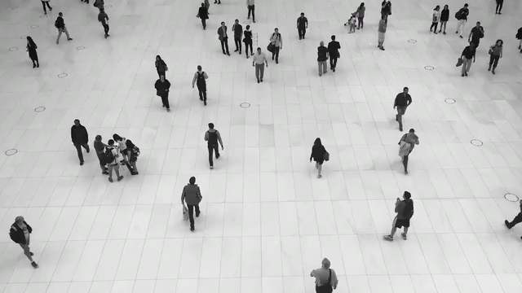
Notes:
Video by <a href="https://pixabay.com/users/coverr-free-footage-1281706/?utm_source=link-attribution&utm_medium=referral&utm_campaign=video&utm_content=6387">Coverr-Free-Footage</a> from <a href="https://pixabay.com//?utm_source=link-attribution&utm_medium=referral&utm_campaign=video&utm_content=6387">Pixabay</a>
面對急診室來來往往的人群

Slide 8
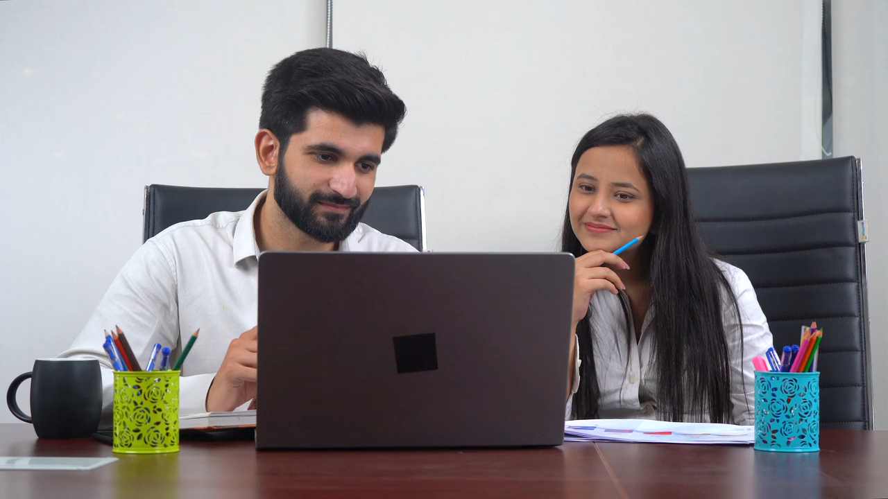
Notes:
Video by <a href="https://pixabay.com/users/aframeinmotion-24244781/?utm_source=link-attribution&utm_medium=referral&utm_campaign=video&utm_content=95122">A frame in motion</a> from <a href="https://pixabay.com//?utm_source=link-attribution&utm_medium=referral&utm_campaign=video&utm_content=95122">Pixabay</a>
看著前輩們自信又俐落的樣子，

Slide 9
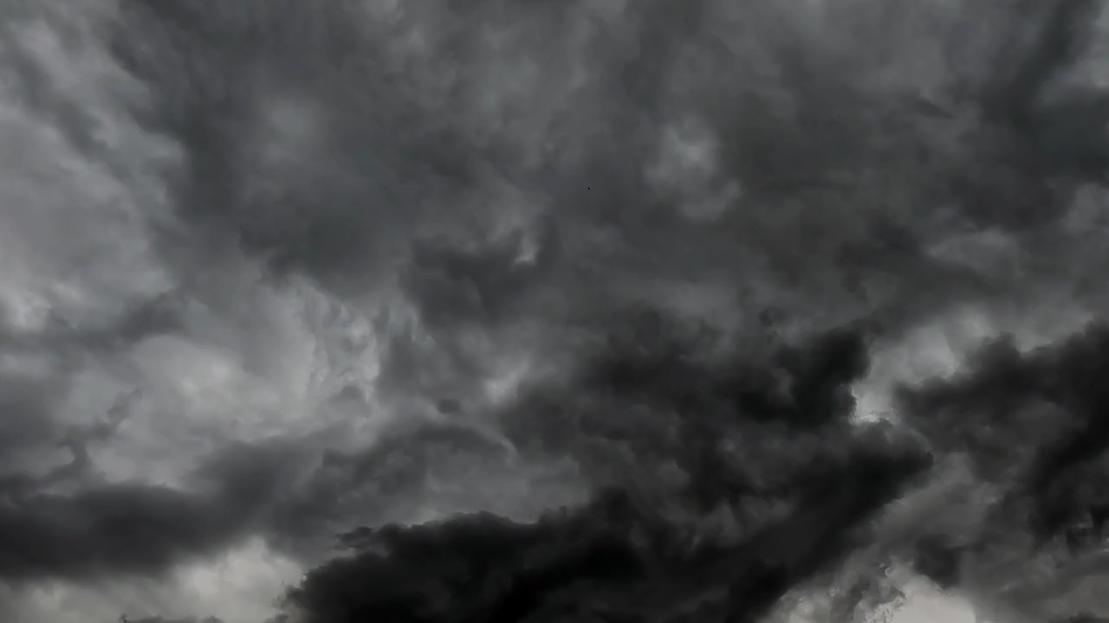
Notes:
Video by <a href="https://pixabay.com/users/kaffeesüchtig-19168820/?utm_source=link-attribution&utm_medium=referral&utm_campaign=video&utm_content=117690">Kaffeesüchtig</a> from <a href="https://pixabay.com//?utm_source=link-attribution&utm_medium=referral&utm_campaign=video&utm_content=117690">Pixabay</a>
我開始擔心起自己能否做好份內工作。

Slide 10

3.努力
Notes:
Video by <a href="https://pixabay.com/users/klimkin-1298145/?utm_source=link-attribution&utm_medium=referral&utm_campaign=video&utm_content=4953">svklimkin</a> from <a href="https://pixabay.com//?utm_source=link-attribution&utm_medium=referral&utm_campaign=video&utm_content=4953">Pixabay</a>
於是我更加努力，

Slide 11
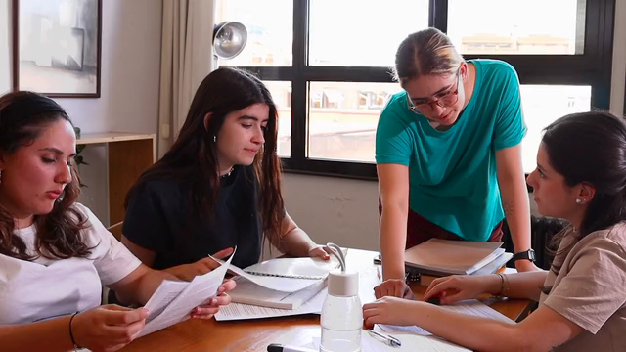
Notes:
Video by <a href="https://pixabay.com/users/eloguers-35030510/?utm_source=link-attribution&utm_medium=referral&utm_campaign=video&utm_content=159027">Elo Guers</a> from <a href="https://pixabay.com//?utm_source=link-attribution&utm_medium=referral&utm_campaign=video&utm_content=159027">Pixabay</a>
白天跟著前輩實習

Slide 12
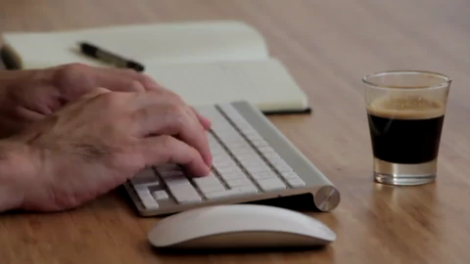
Notes:
Video by <a href="https://pixabay.com/users/coverr-free-footage-1281706/?utm_source=link-attribution&utm_medium=referral&utm_campaign=video&utm_content=1046">Coverr-Free-Footage</a> from <a href="https://pixabay.com//?utm_source=link-attribution&utm_medium=referral&utm_campaign=video&utm_content=1046">Pixabay</a>
晚上繼續抱著電腦學習

Slide 13

4.結果
Notes:
Video by <a href="https://pixabay.com/users/engin_akyurt-3656355/?utm_source=link-attribution&utm_medium=referral&utm_campaign=video&utm_content=23835">Engin Akyurt</a> from <a href="https://pixabay.com//?utm_source=link-attribution&utm_medium=referral&utm_campaign=video&utm_content=23835">Pixabay</a>
最終，

Slide 14
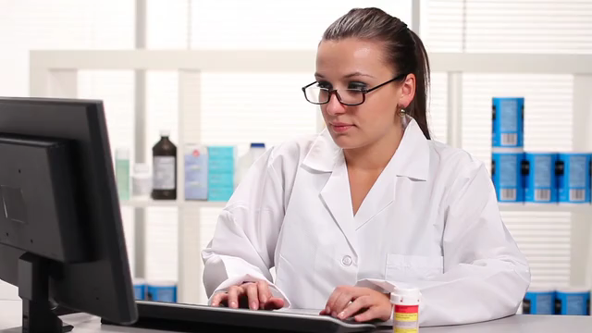
Notes:
Video by <a href="https://pixabay.com/users/luqz707-12693130/?utm_source=link-attribution&utm_medium=referral&utm_campaign=video&utm_content=26732">Emagrecer saúde</a> from <a href="https://pixabay.com//?utm_source=link-attribution&utm_medium=referral&utm_campaign=video&utm_content=26732">Pixabay</a>
我發現我面對一些突發的小情況，已經能夠妥善處理，不再緊張

Slide 15
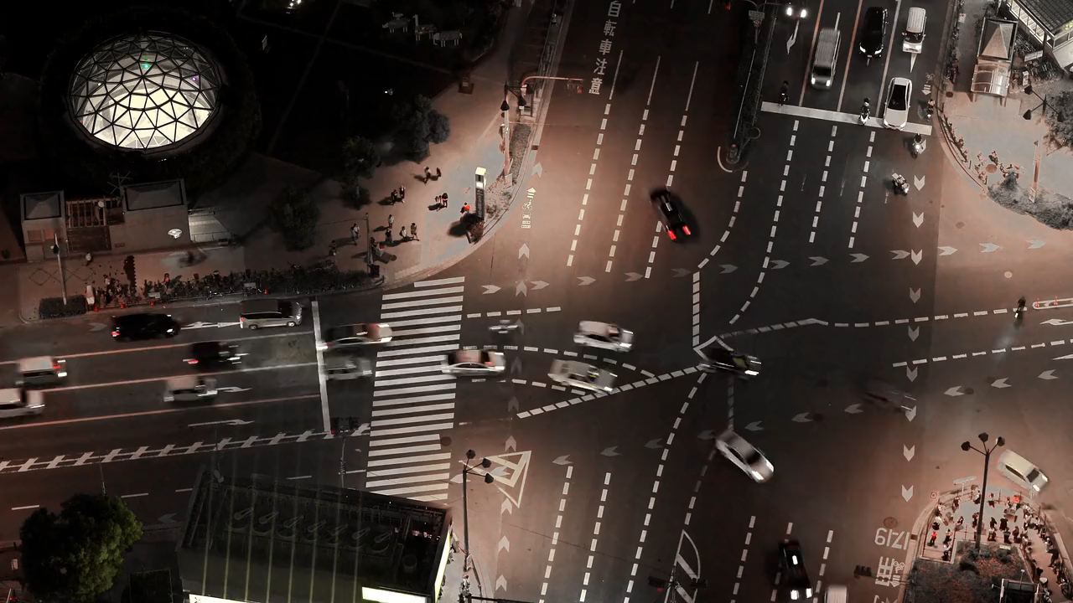
5.意外
Notes:
Video by <a href="https://pixabay.com/users/kanenori-4749850/?utm_source=link-attribution&utm_medium=referral&utm_campaign=video&utm_content=180386">Kanenori</a> from <a href="https://pixabay.com//?utm_source=link-attribution&utm_medium=referral&utm_campaign=video&utm_content=180386">Pixabay</a>
然而就在一天夜晚，

Slide 16
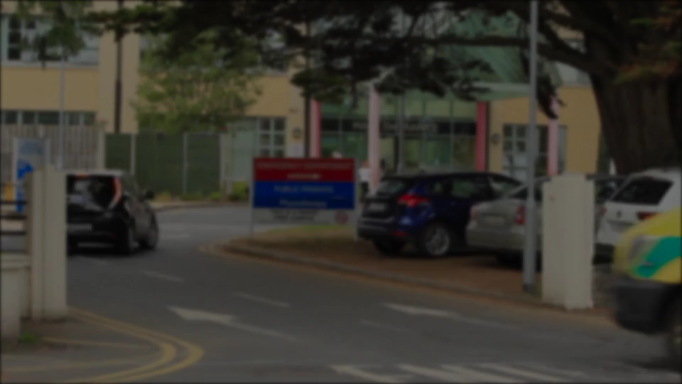
Notes:
Video by <a href="https://pixabay.com/users/conolan-4525104/?utm_source=link-attribution&utm_medium=referral&utm_campaign=video&utm_content=27385">conolan</a> from <a href="https://pixabay.com//?utm_source=link-attribution&utm_medium=referral&utm_campaign=video&utm_content=27385">Pixabay</a>
一位心臟病發的患者被緊急送進急診室，

Slide 17

Notes:
Video by <a href="https://pixabay.com/users/amorn_mimi-27759397/?utm_source=link-attribution&utm_medium=referral&utm_campaign=video&utm_content=187516">Amorn Chumnit</a> from <a href="https://pixabay.com//?utm_source=link-attribution&utm_medium=referral&utm_campaign=video&utm_content=187516">Pixabay</a>
當時沒有其他醫生在場，只能由我跟護士啟動急救程序。面對這樣的壓力，我不禁又緊張起來，手心冒著冷汗。

Slide 18

Notes:
Video by <a href="https://pixabay.com/users/olenchic-16658974/?utm_source=link-attribution&utm_medium=referral&utm_campaign=video&utm_content=197658">Olena</a> from <a href="https://pixabay.com//?utm_source=link-attribution&utm_medium=referral&utm_campaign=video&utm_content=197658">Pixabay</a>
此時每分每秒都顯得格外漫長。

Slide 19
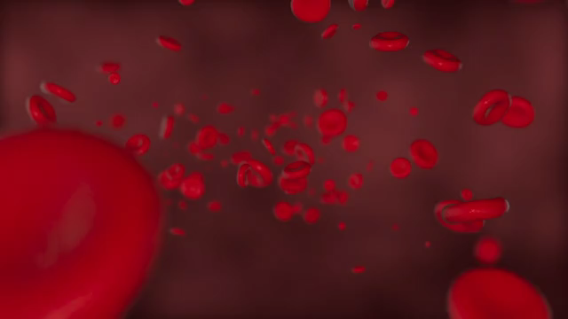
6.轉彎
Notes:
Video by <a href="https://pixabay.com/users/motionstock-13298494/?utm_source=link-attribution&utm_medium=referral&utm_campaign=video&utm_content=35461">motionstock</a> from <a href="https://pixabay.com//?utm_source=link-attribution&utm_medium=referral&utm_campaign=video&utm_content=35461">Pixabay</a>
正當我準備使用除顫器時，

Slide 20

Notes:
Video by <a href="https://pixabay.com/users/royburi-3128024/?utm_source=link-attribution&utm_medium=referral&utm_campaign=video&utm_content=22704">Roy Buri</a> from <a href="https://pixabay.com//?utm_source=link-attribution&utm_medium=referral&utm_campaign=video&utm_content=22704">Pixabay</a>
主治醫師匆忙趕到，接手了治療。

Slide 21
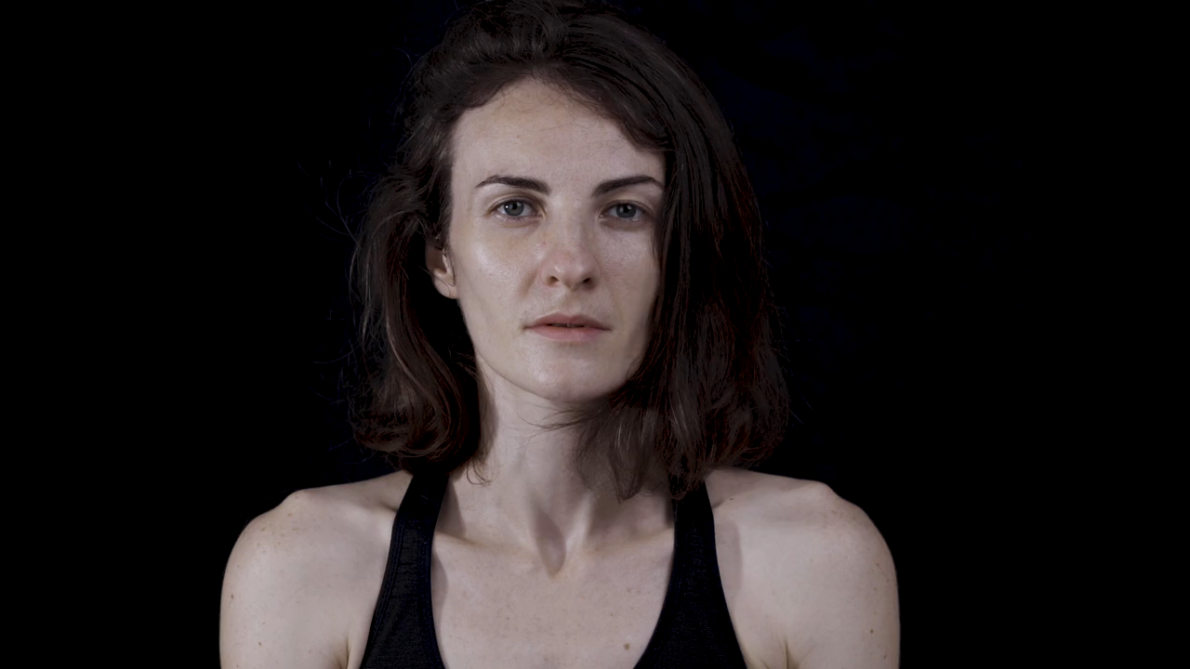
7.結局
Notes:
Video by <a href="https://pixabay.com/users/engin_akyurt-3656355/?utm_source=link-attribution&utm_medium=referral&utm_campaign=video&utm_content=44637">Engin Akyurt</a> from <a href="https://pixabay.com//?utm_source=link-attribution&utm_medium=referral&utm_campaign=video&utm_content=44637">Pixabay</a>
儘管我認為自己面對這樣危機的處置有很大的改進空間，

Slide 22
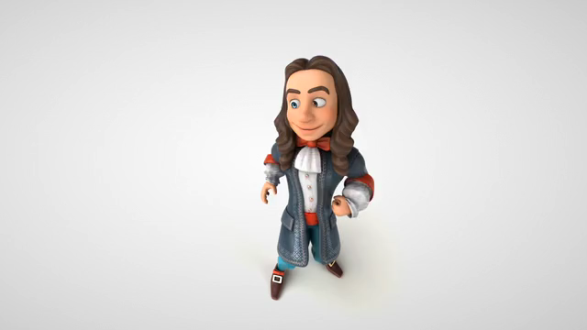
Notes:
Video by <a href="https://pixabay.com/users/julientromeur-3630051/?utm_source=link-attribution&utm_medium=referral&utm_campaign=video&utm_content=117358">Julien Tromeur</a> from <a href="https://pixabay.com//?utm_source=link-attribution&utm_medium=referral&utm_campaign=video&utm_content=117358">Pixabay</a>
主治醫師仍誇讚我面對這樣的情況能冷靜處理是成為一個優良醫師的重要特質

Slide 23
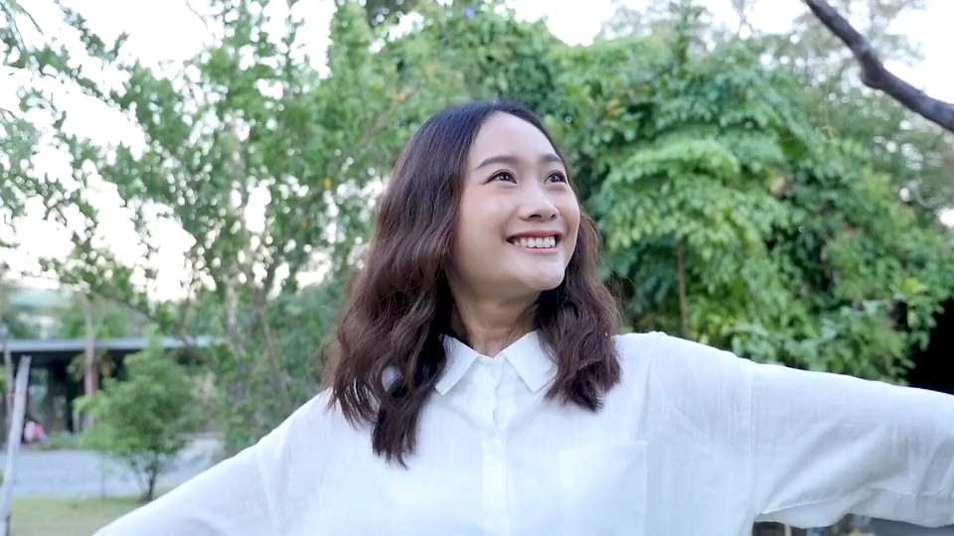
Notes:
Video by <a href="https://pixabay.com/users/piyapong89-7158719/?utm_source=link-attribution&utm_medium=referral&utm_campaign=video&utm_content=83860">Piyapong Saydaung</a> from <a href="https://pixabay.com//?utm_source=link-attribution&utm_medium=referral&utm_campaign=video&utm_content=83860">Pixabay</a>
他的誇讚給了我信心，讓我更有勇氣面對未來的挑戰。

